Slide 1
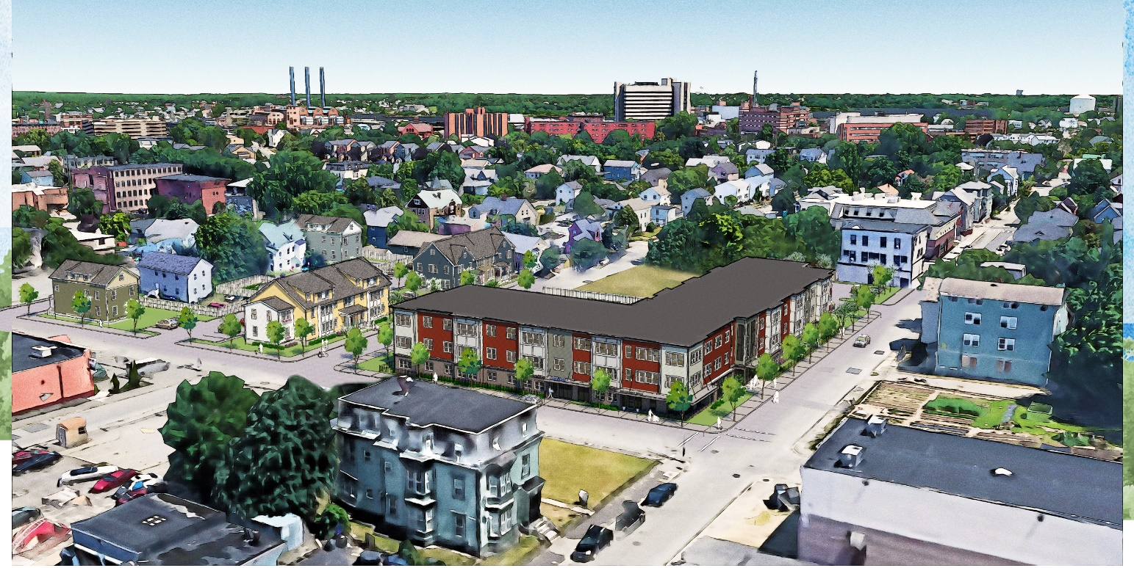




Providence Housing Authority
Board
Presentation
October 22, 2020
Joseph Caffey Apartments, LP
Providence, Rhode Island

Slide 2
Development Team
  Omni Development Company, Providence, R
  Wingate Companies, Newton, MA.
  DBVW Architects, Providence, RI
  Pezzuco Construction, Cranston, RI
  Barbara Sokoloff Associates, Providence, RI

Slide 3
Takeaways from the community engagement meetings.
Concerns the redeveloped Barbara Jordan II will have rents too high for members of the community.
Concerns of previous residents’ rights to move into the new housing
3. Preference that the buildings be rehabilitated and preserved as opposed to
being torn down and rebuilt
Renovating the apartments is quicker and we need housing now
5. Desire for an increased number of apartments above the original 74 units, coupled with
thoughtful consideration for housing types. Residents expressed a preference for
townhouses.

Slide 4
What we heard (con’t)
6. Desire for a tenant-controlled development, through a tenant’s union and eventual cooperative
7. Strong desire for the development to be permanently
affordable
8. Preference to hire local contractors and businesses to
conduct the redevelopment

Slide 5
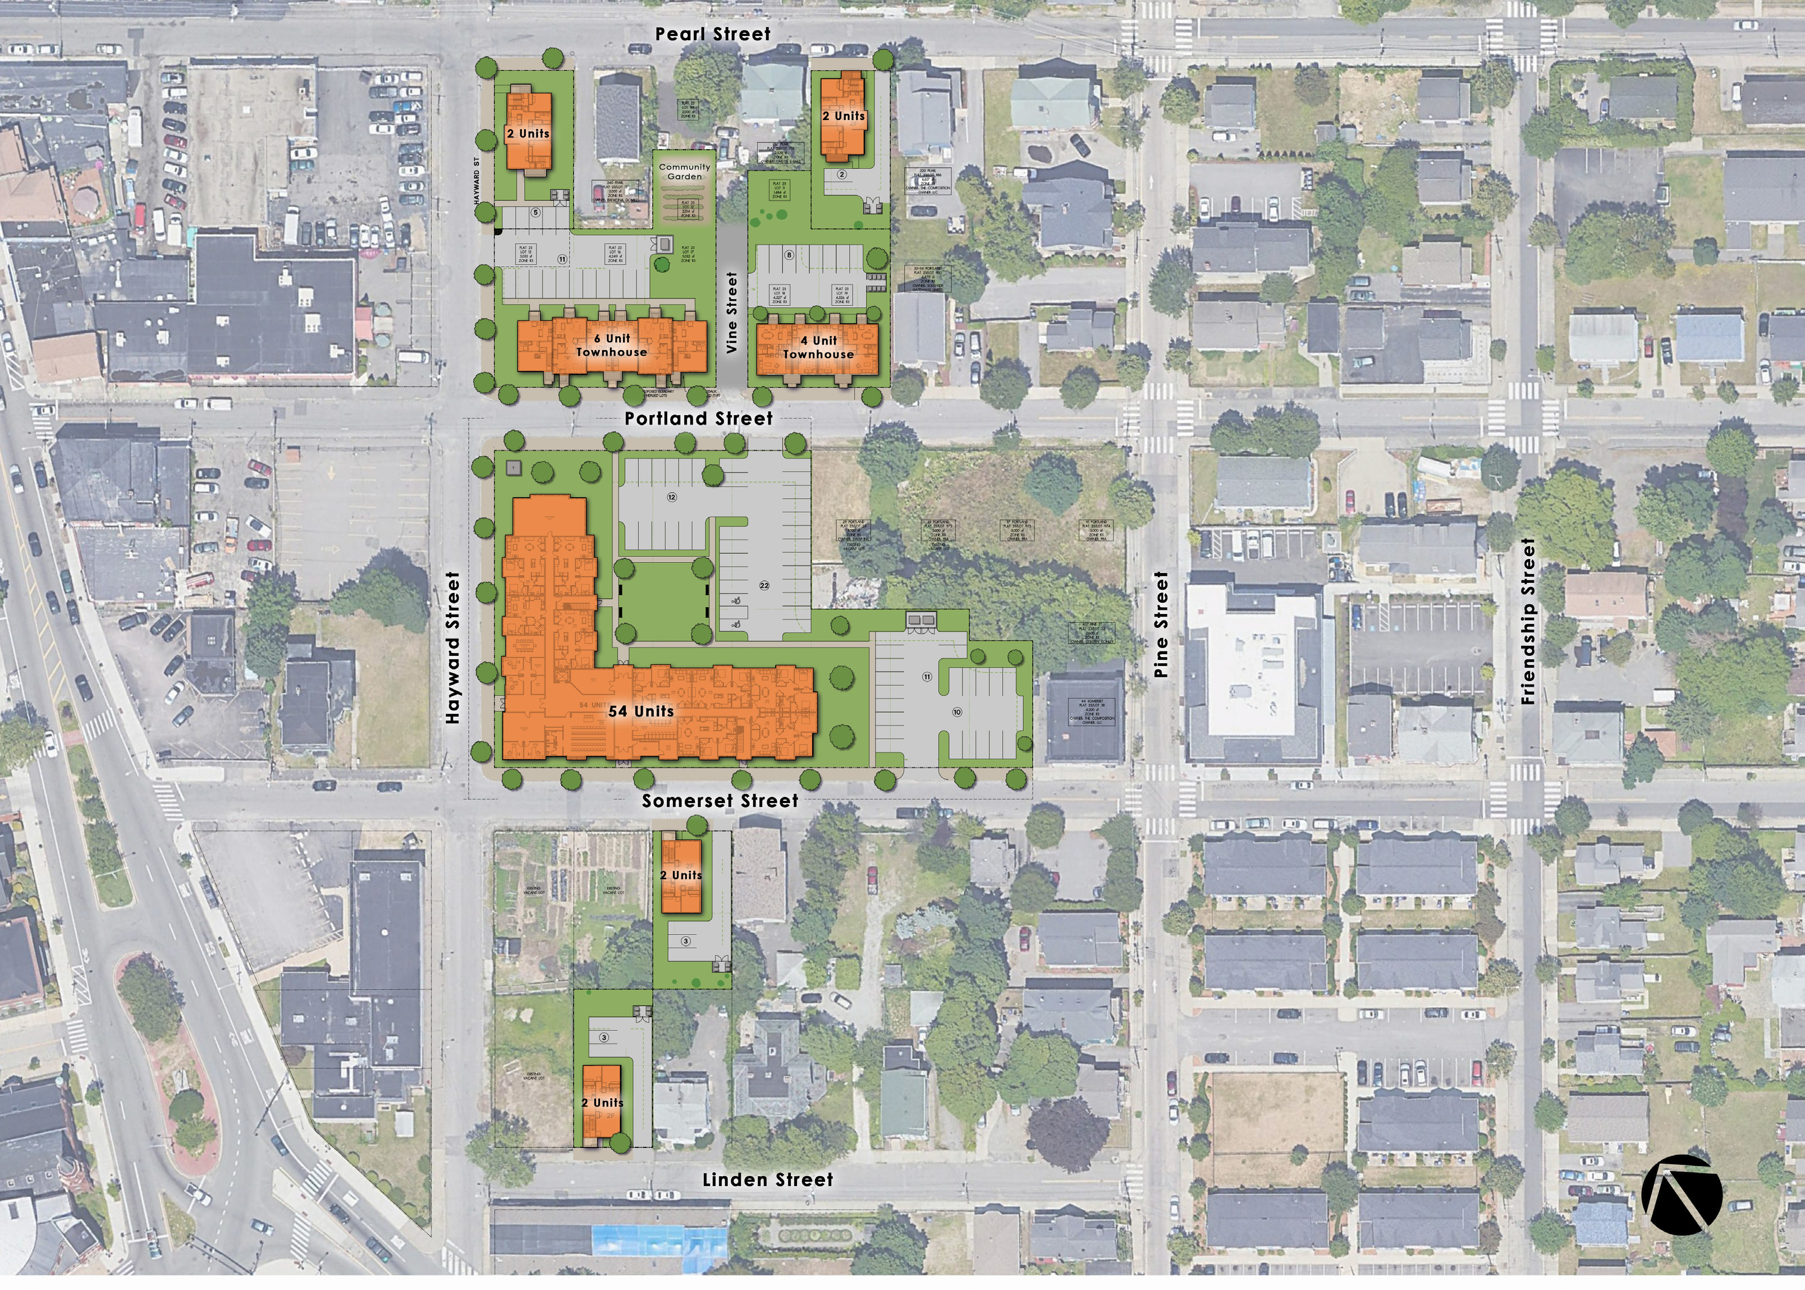

72 Units in
Northern Cluster.
68 Rental Units
4 -Homeownership

Slide 6
How do we achieve this building design
16 Somerset Street, Providence
This single building will consist of 54 units. In order to construct this building 10 existing vacant multi-family buildings between Portland Street and Somerset Street will be demolished and these lots will be merged.
We are currently working the Zoning and CPC Departments to satisfy all request.

Slide 7
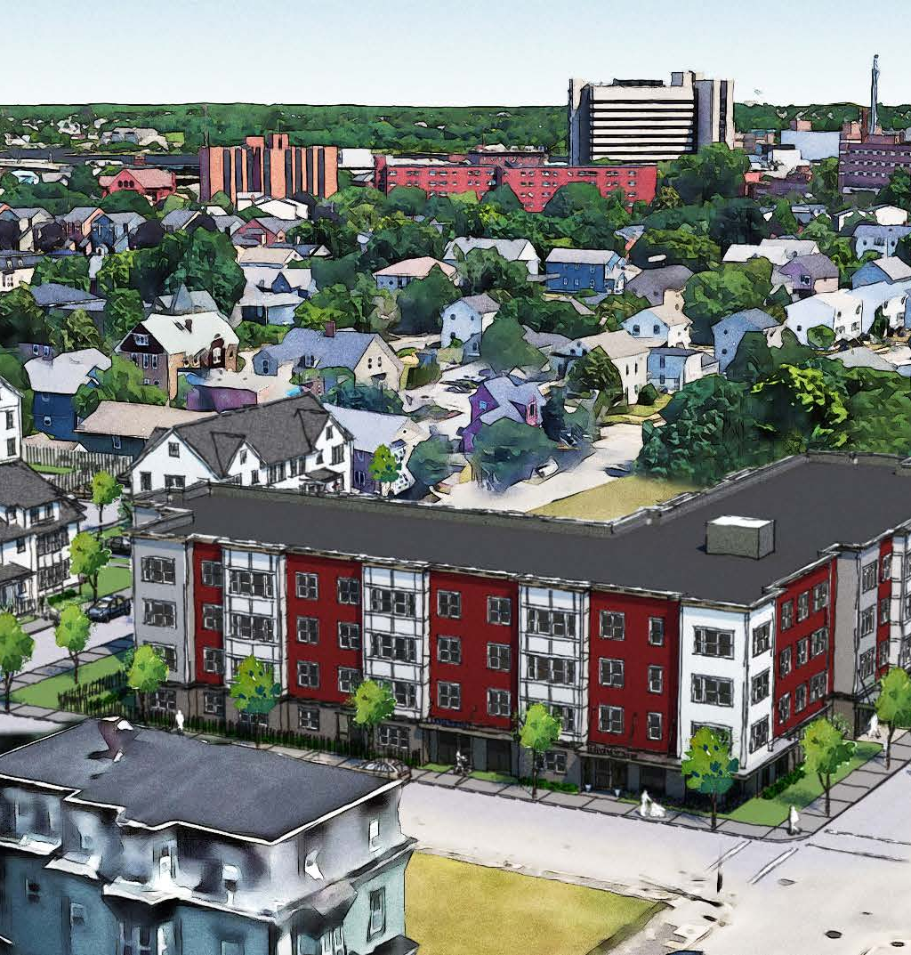
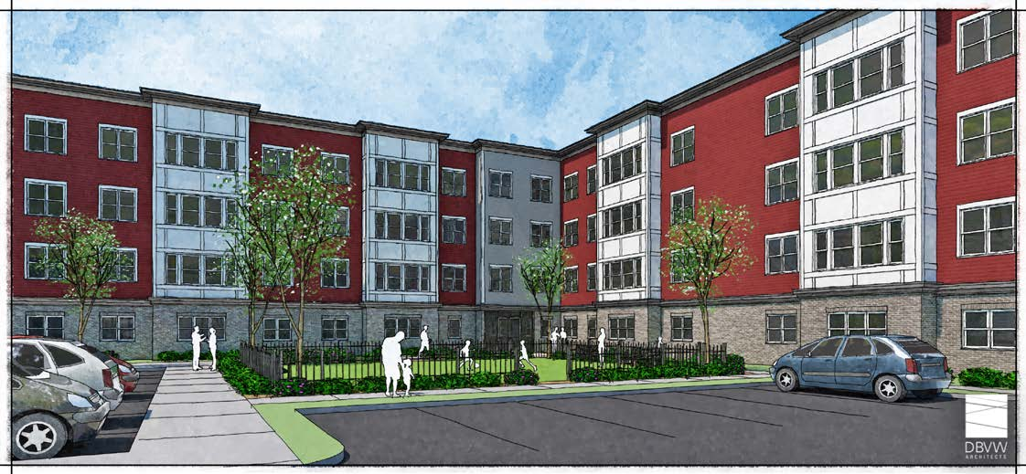
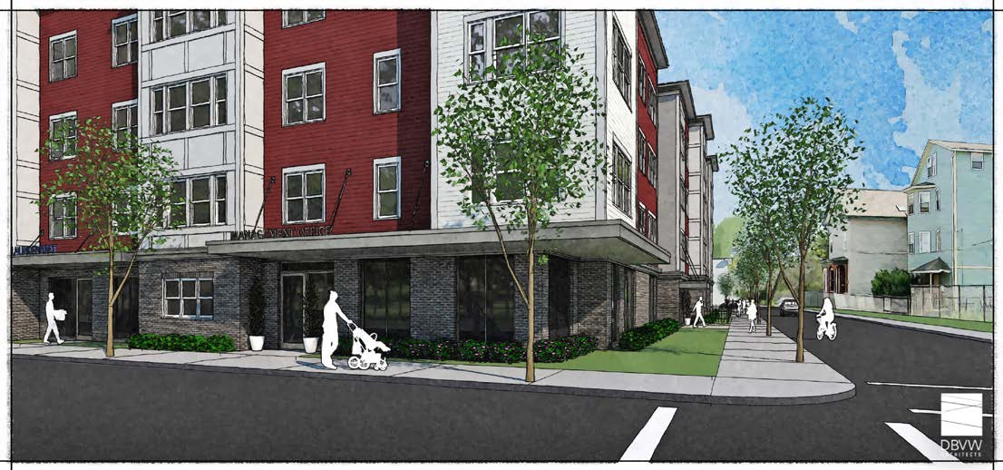
Building D
16 Somerset Street
Providence, RI 02907

Slide 8
16 Somerset will include the following design/operational elements
• On-site property management office
• On-site community meeting space
• On-site space for colocation of service providers
• On-site laundry facilities
• On-site property management and maintenance staff as well as service coordinator.
• Open, yet protected greenspace/common areas
• Improved sidewalks, exterior lighting, CPTED elements and landscaping to encourage safety and walkability.
• Energy efficient design and construction to reduce operating costs and reduce carbon footprint.
• Attractive and durable materials to ensure marketability and long-term maintainability.
• Solar panel array to reduce operating expenses and carbon footprint.
• Tier 2 NGRID & Energy Star 3.1 standards compliance
• As an elevator building, all units will be designed to meet International Building Code requirements for Type B units, frequently referred to as “visitable.” This is a unique opportunity to provide more accommodation for people of varying physical abilities.
• Apprenticeship opportunities in construction and management
• Aggressive MBE/WBE goals based on a successful track record of high utilization

Slide 9
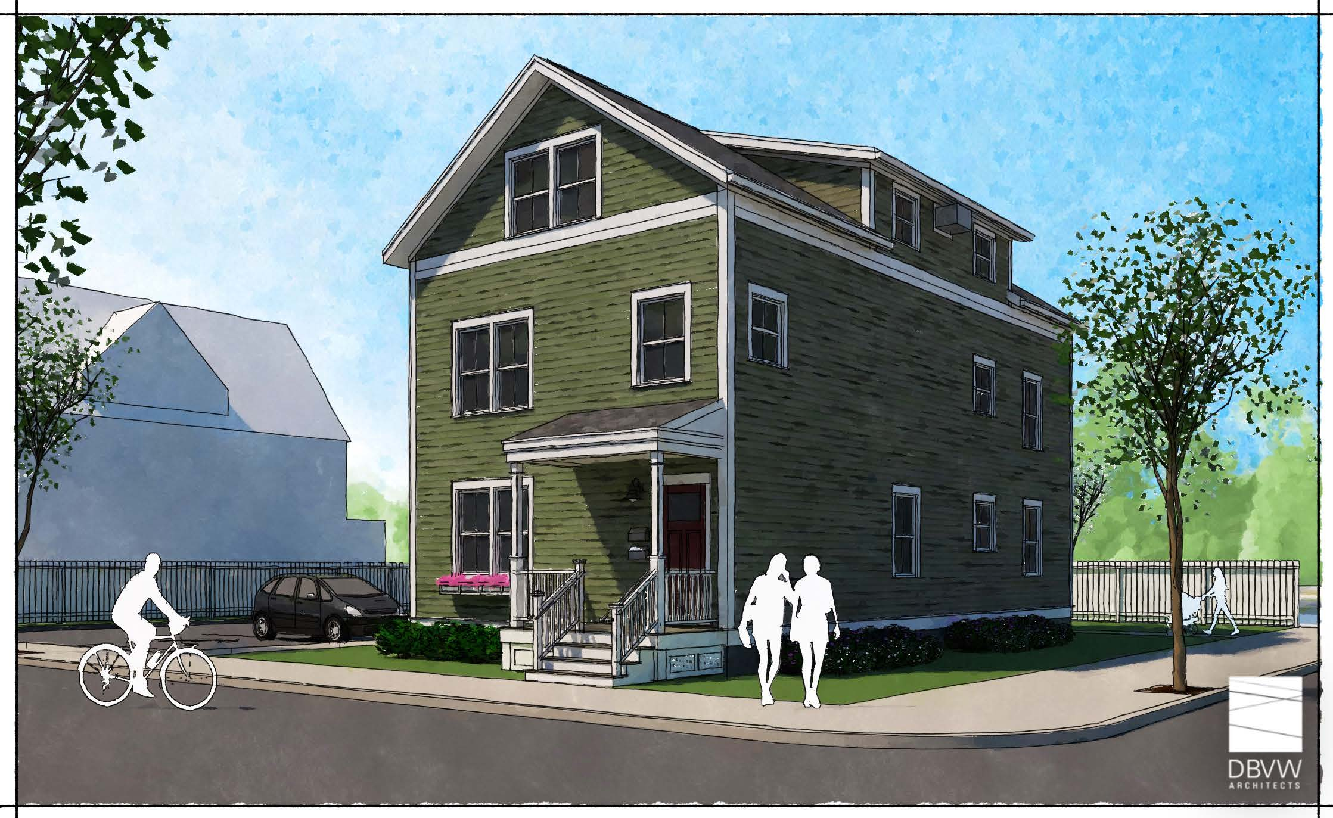
Building A
2 Bed Flat + 1 Bath
(1) 4 Bed Townhouse + 2 Bath

Slide 10
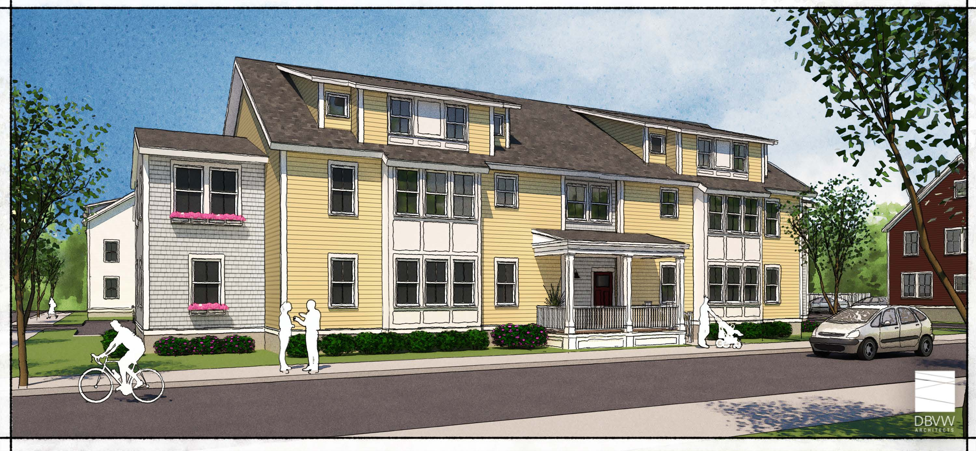
Building B
6 Unit (2 –3 bed Flats and 4-3 bed TH)

Slide 11
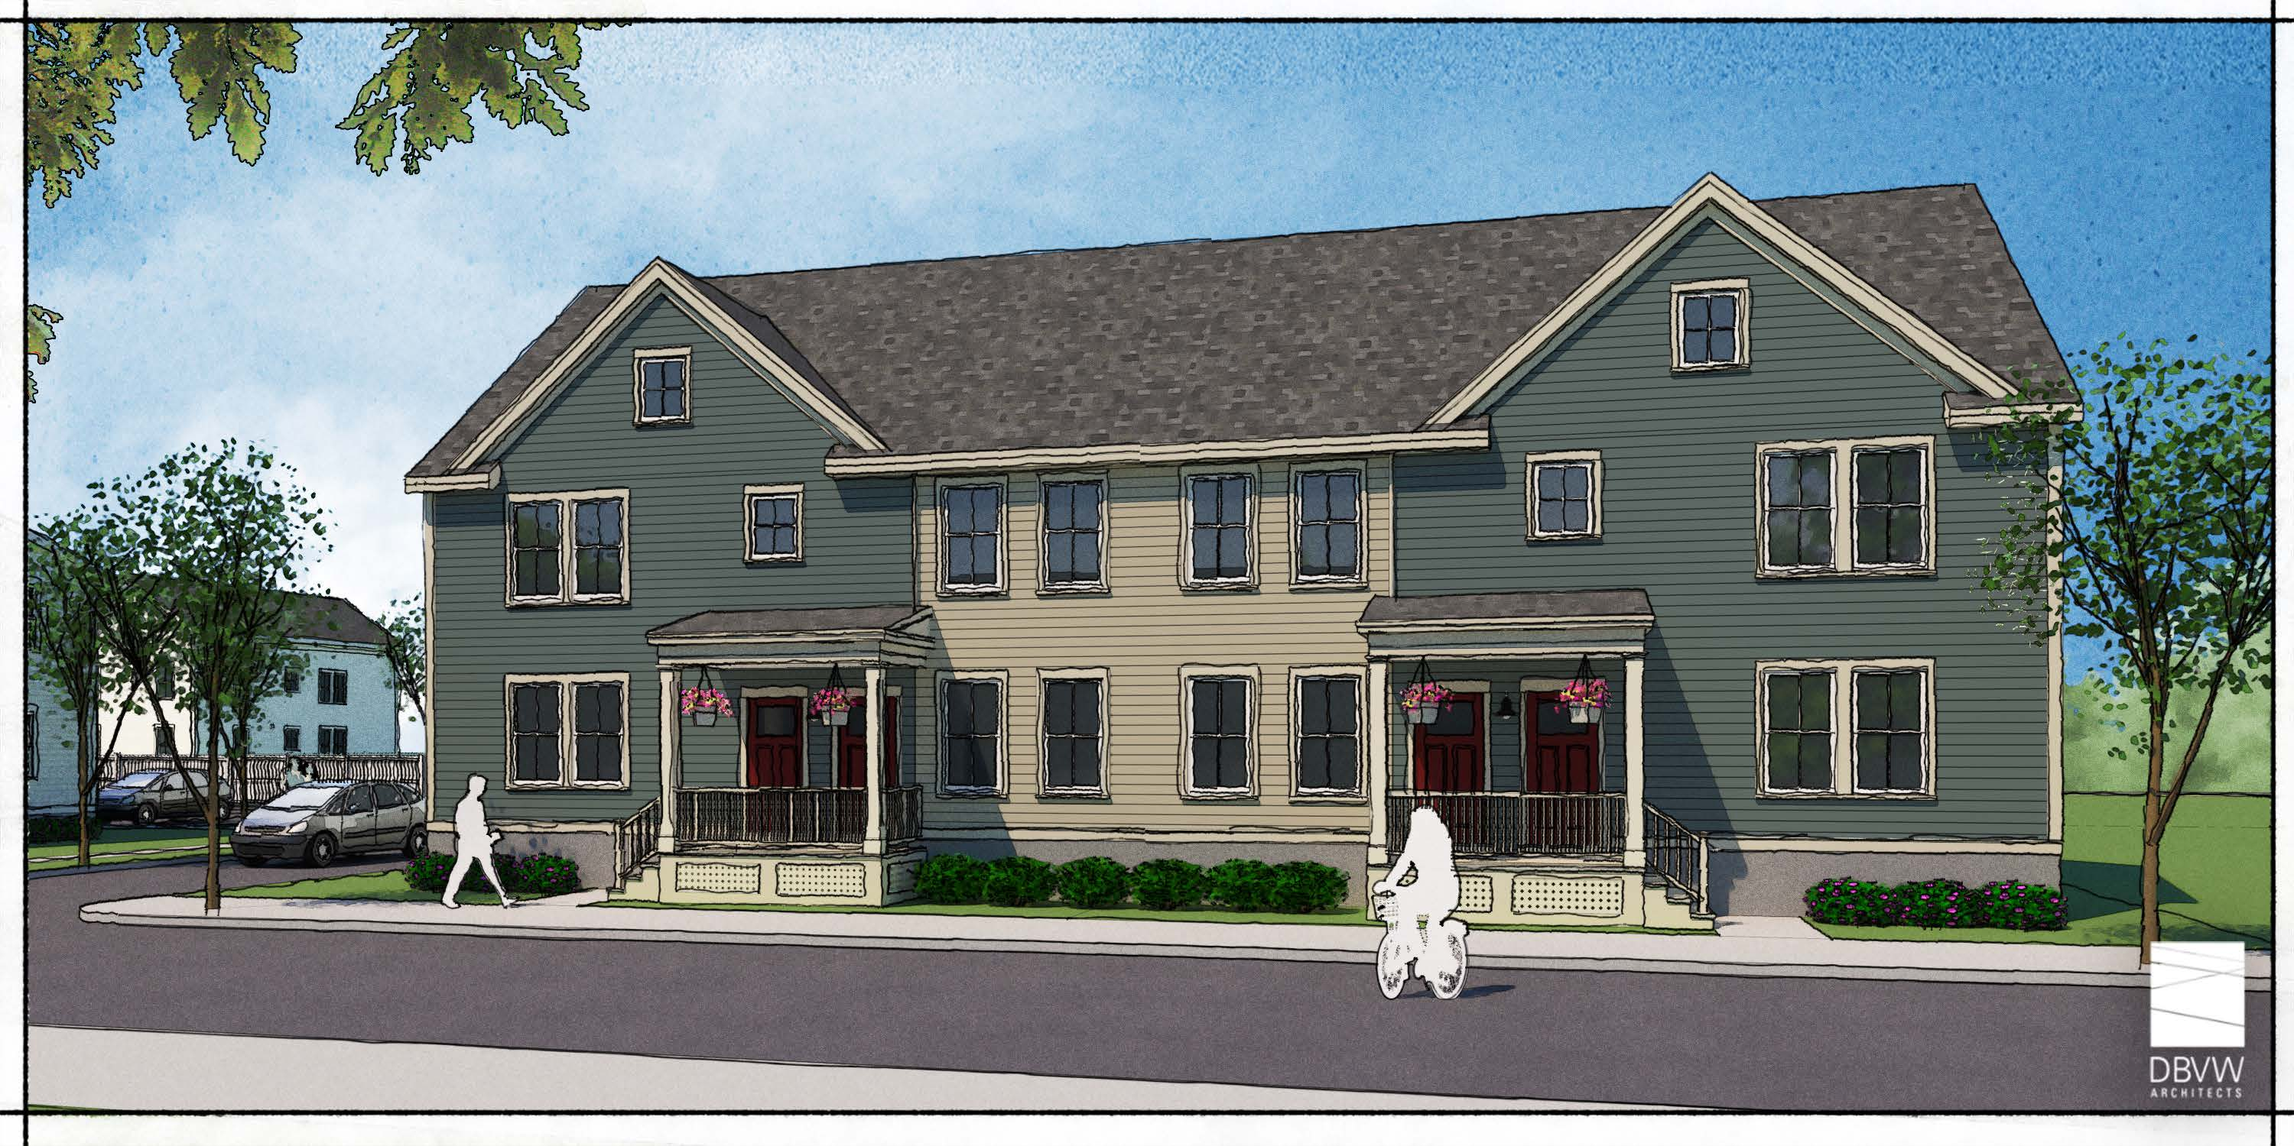
HOME OWNERSHIP
(2) 2 Bed Townhouse + 1.5 Bath
(2) 3 Bed Townhouse + 1.5 Bath

Slide 12
11 Rental Units Southern Cluster

Slide 13
Building C
(2) 2 Bed Townhouse + 1.5 Bath
(2) 3 Bed Townhouse + 1.5 Bath

Slide 14
Building A
2 Bed Flat + 1 Bath
(1) 4 Bed Townhouse + 2 Bath

Slide 15
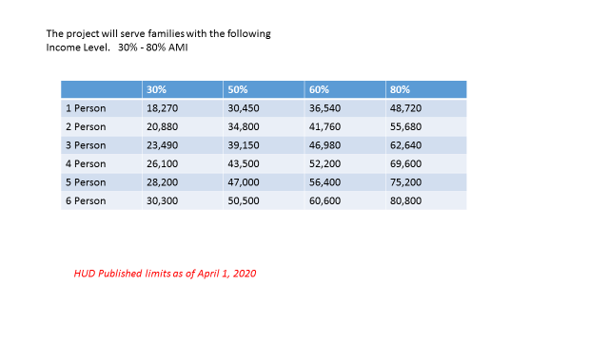

Slide 16
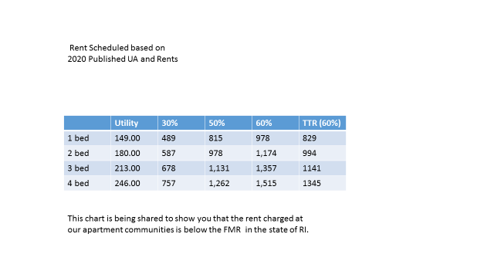
Our request for the 8 PBV’s will provide access to families with very low income.

Slide 17
Unit Count
Rental Unit Composition
10 1 bed units
36 2 Bed units
27 3 bed Units
6 4 bed units
Home Ownership
2 2 bed units
2 3 bed units

Slide 18
Development Model
In order to successfully redevelop this property, financing will be bifurcated into two distinct tranches;
9% LIHTC (44 units) – Joseph Caffey Apartments
4% tax-exempt (25 units) Jordan Caffey Townhomes
While there will be no outward physical or operational differences between the two executions, this structure allows us to reduce the amount of state cap LIHTC’s required – the alternative being a two-year allocation and a staged development – and instead develop the entire project in a single phase

Slide 19
Recent affordable housing development completed by Omni.
Managed by Wingate Management
**Model similar to Barbara Jordan**
Davis Gardens was completed in 2016 and 2017. The property consists of 122 units of LIHTC and 15 project based subsidized units.
14 buildings consisting of new townhouses, loft and garden style apartments. This project offers one, two and three bedrooms apartments.
A new community building with laundry, management office and free wi-fi enable community room for resident functions and supportive services.
The RSC provides supportive services to the residents on site. The services provided on site are:
Financial literacy, health fairs, homework and chill, CT Food Bank Grow Truck, and various holiday events.

Slide 20
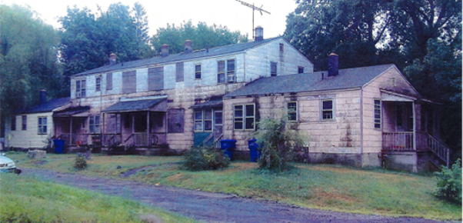
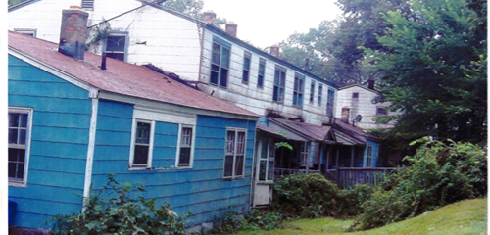
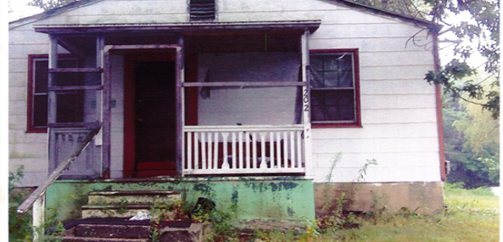
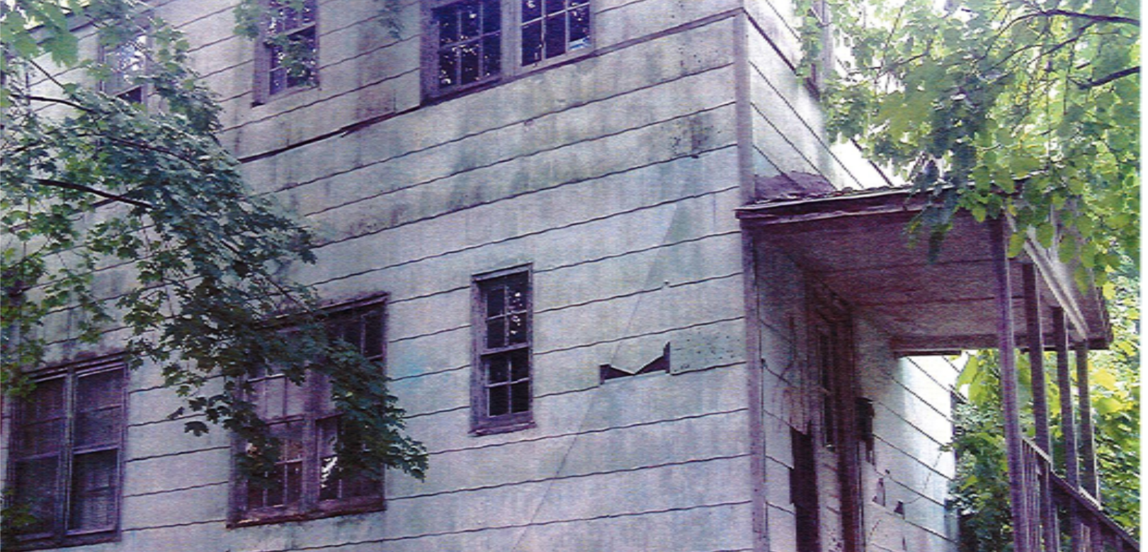
Davis Gardens (BEFORE PICTURES)

Slide 21
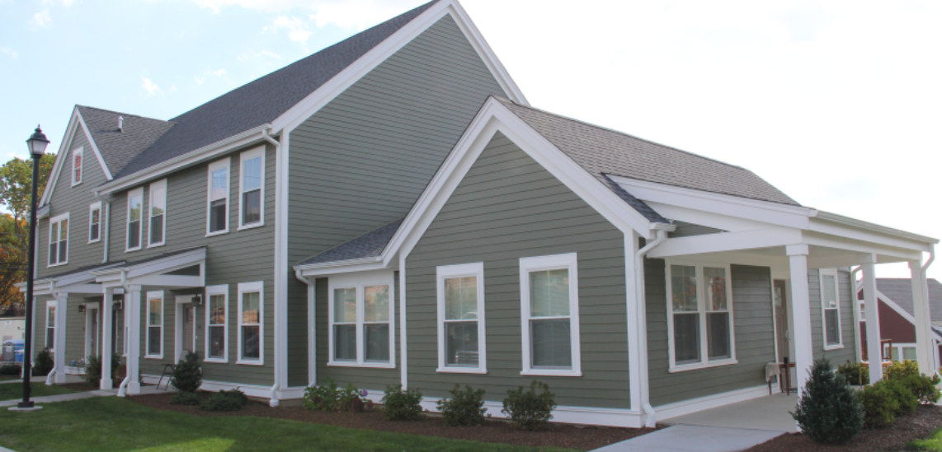
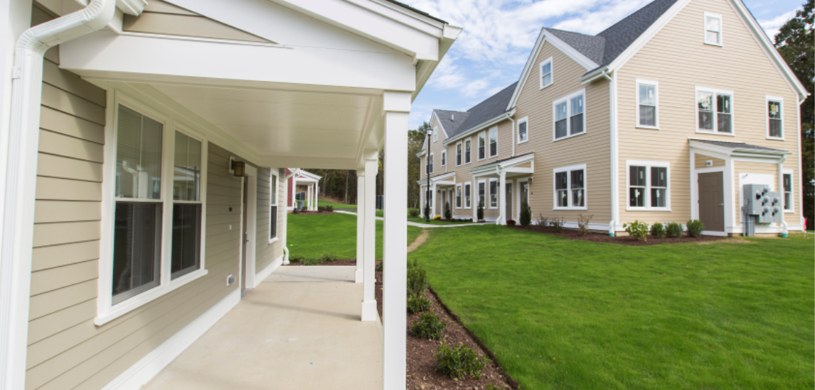
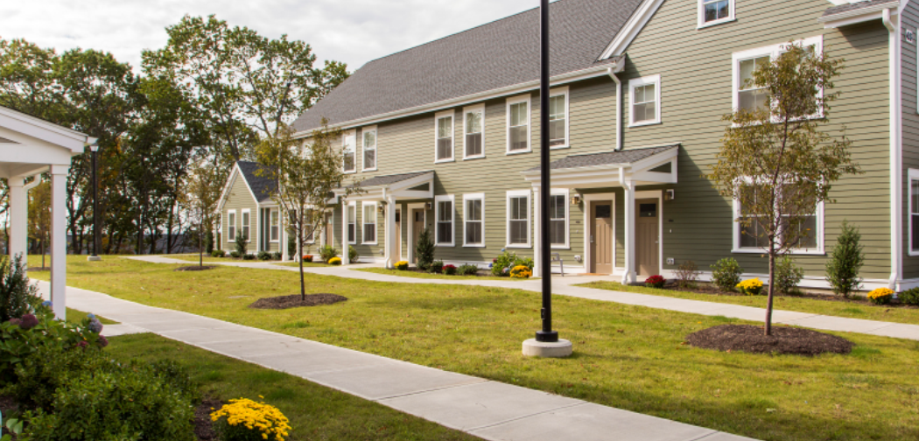
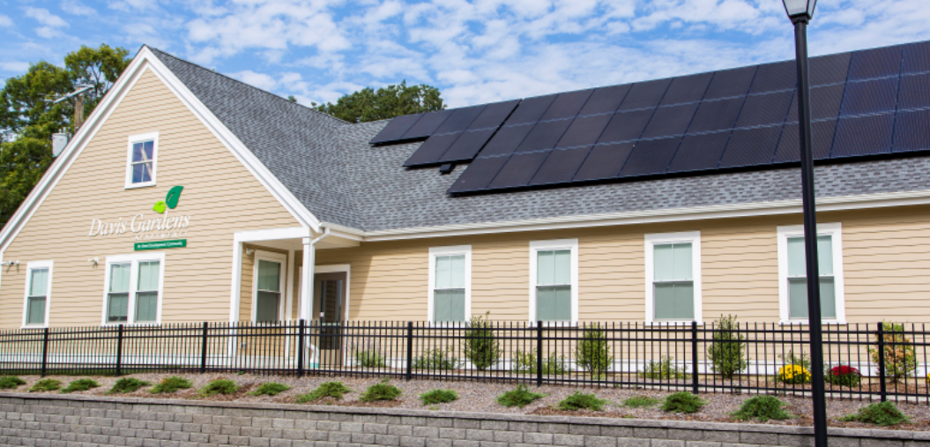
After Photos, project competed 2017 and 2018

Slide 22
Summary:
The architect for this project was DBVW (Virginia Branch and Karissa Kuhns)
Barbara Sokoloft and Associates was development consultant for this project
Both firms were part of the successful planning and execution of this successful project was shared in the previous slide.

Slide 23
Letters of Support & Continued community engagement
Institute of Non-Violence
DARE
AMOS House,
YouthBuild
Providence NAACP
OIC
Senator Harold Metts, long-term resident of the neighborhood
Former Tenant
Local Pastor
During the summer of 2019 we collected signatures from community residents
July 22, 2022 – Community engagement held via Zoom. 19 people attended
September 22, 2022 – Community engagement held via Zoom. Held in conjunction with DARE, and SPNA, 27 people attended (49 individuals RSVP’d)

Slide 24
Why Omni/Wingate
All New Construction
Full time resident service coordinator, Property Manager and Maintenance
Local developer (Omni) with extensive community ties and relationships and experience working in upper south Providence neighborhoods partnered with regional experienced and well-capitalized developer/investor/property manager (Wingate) to leverage their respective strengths.
Experienced development team exhibiting a proven track record of financing, designing, constructing and managing complicated projects.
Ready to get the job done

Slide 25
Thank You,
Ralph Cole, Wingate
Elizabeth Schuster, Wingate
Sharon Morris, Omni Development
Ashley Barge, Omni Development
Thank you all for your time this evening

